Slide 1

March vacation
M

Slide 2

Objective
Scrape hotel and flight data from travel booking websites
Upload the data to HDFS then connect to MySQL
Analyze data using MySQL to answer business queries
M

Slide 3

Problem Statement
“How can travelers find the best hotel and flight deals while optimizing for budget, location, and customer satisfaction?”
Provide insights into pricing trends, hotel popularity, and customer satisfaction for stays between March 12-31.
M

Slide 4

Tools Used
Selenium-To scrape dynamic websites
Tailscale – To set clusters
Docker – Make Swarm
Hadoop HDFS- Used to store data
MySQL – Used to manipulate data
Git & GitHub – To store source code and project files

Slide 5

Web Scraping
Using Selenium
Hotel information
Booking.com and Hotels.com
Scraped hotel image, address, featured customer review, rating, price, room type etc.
Flight Information
Flightslist.io
Scraped departure origin, return origin, airline name and price from the website
M

Slide 6
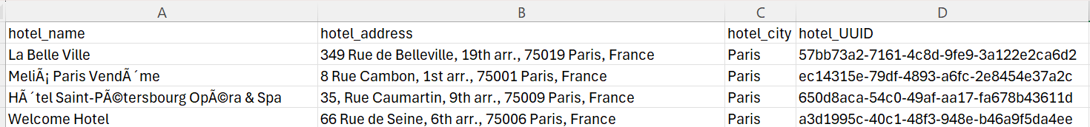
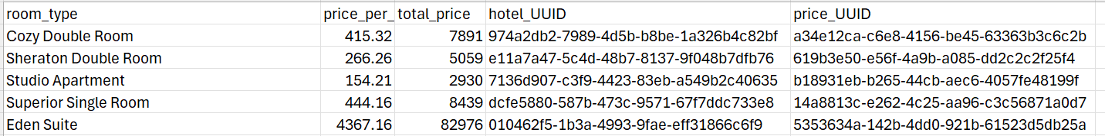
Data collection
Csv files and their structure
1. Hotels.csv
2.Prices.csv
M

Slide 7
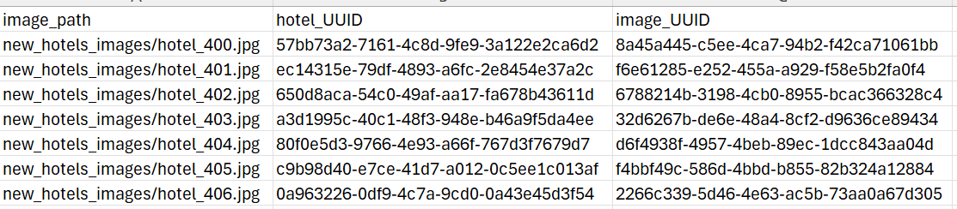
Data collection
Csv files and their structure
3.Reviews.csv
4.Images.csv
M

Slide 8
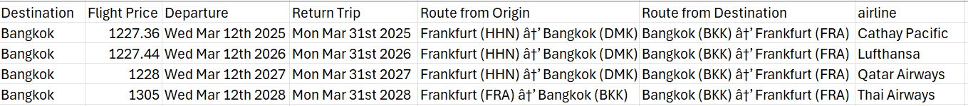
Data collection
Csv files and their structure
5. Flights.csv
M

Slide 9
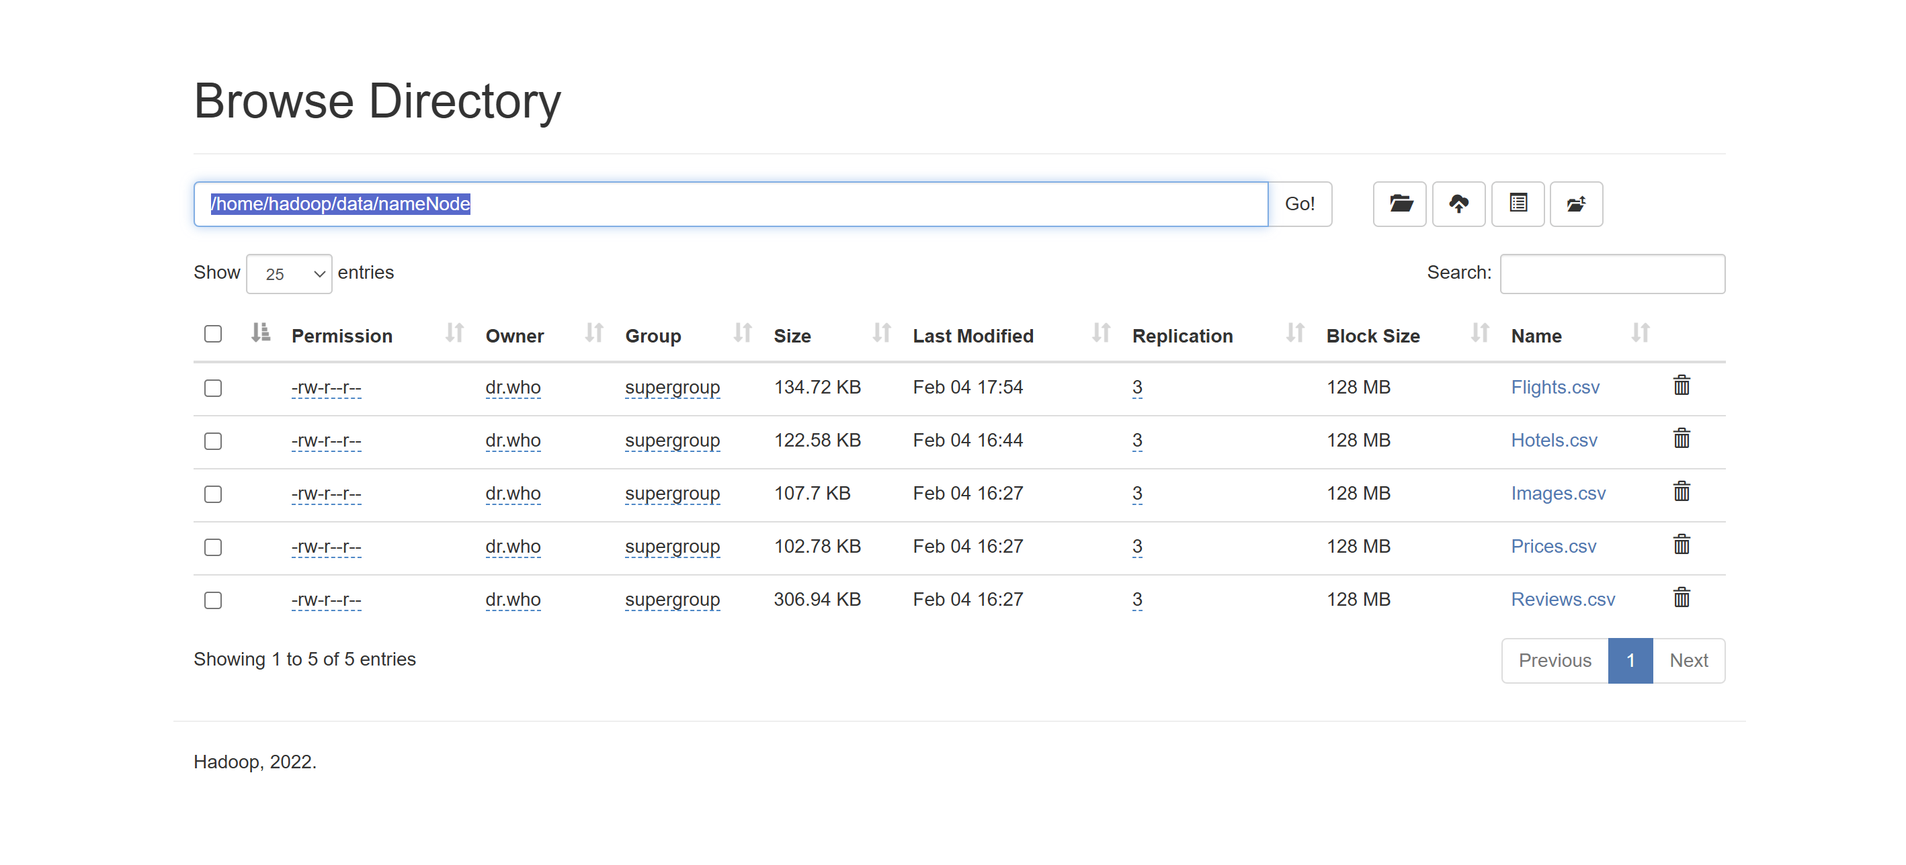
Storing data in hdfs
Master Node starts docker swarm
Master Node deploys Cluster.yml
Access HDFS UI Make sure all 3 data nodes are displayed
m

Slide 10
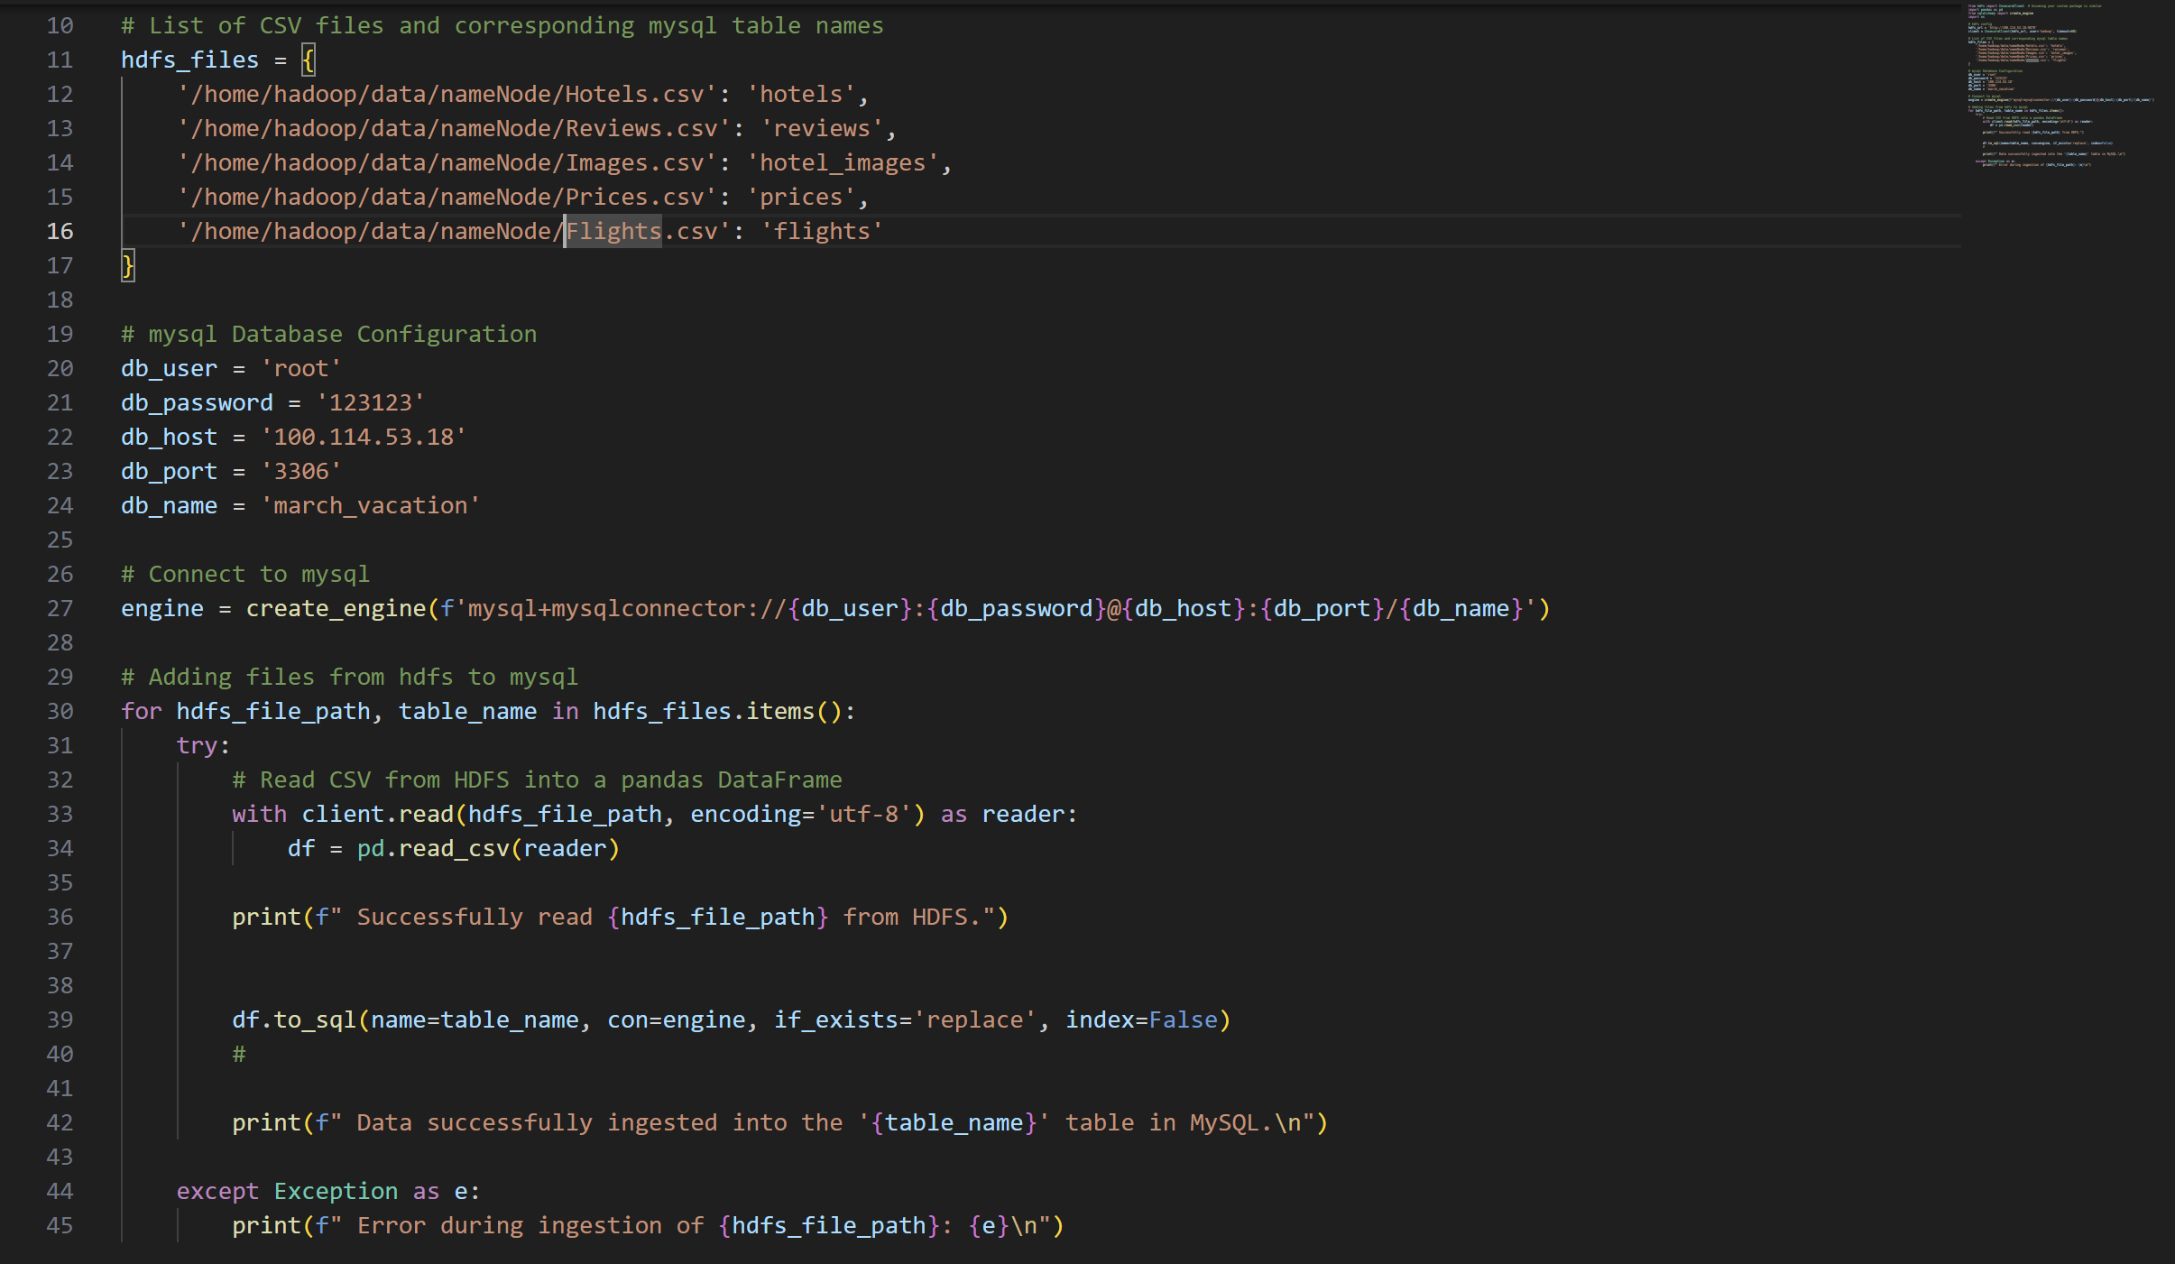
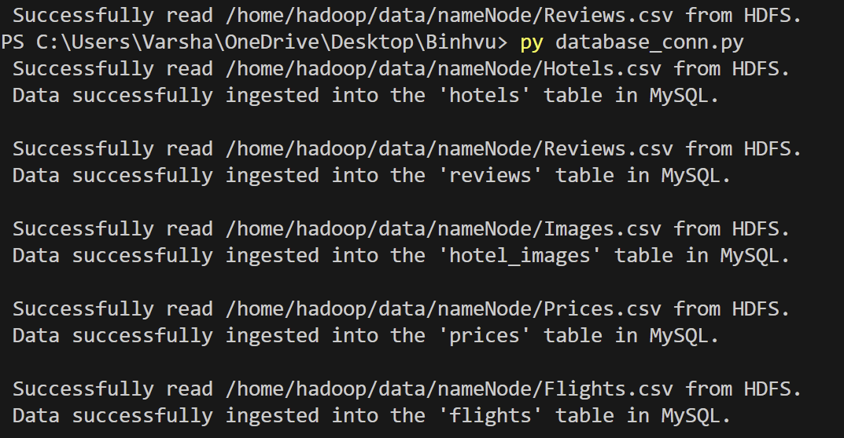
Connecting to SQL
Via Python
m

Slide 11

Business quesitons
What are the available flights for each desitnation?
What is the average price per night for hotels in different cities?
What is the average hotel rating per city?
Which are the top 5 hotels by customer ratings?
What is the cheapest flight route?
Which hotels offer the best value?
What are the details of the selected hotel?

Slide 12
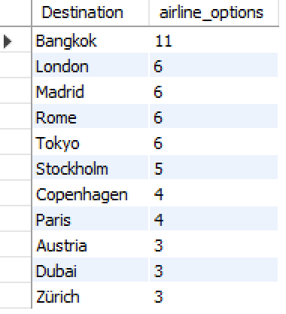
Flights availability for each destination
SELECT Destination, COUNT(DISTINCT airline) as airline_options
FROM flights
GROUP BY Destination
ORDER BY airline_options DESC;
M

Slide 13
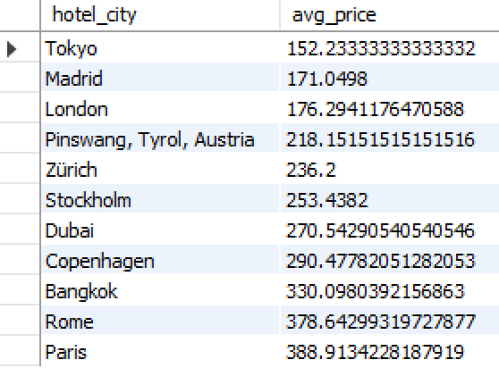
Average Price Per night for hotels in different cities
SELECT h.hotel_city, AVG(p.price_per_night)
AS avg_price
FROM hotels h
JOIN prices p ON h.hotel_UUID =p.hotel_UUID
GROUP BY h.hotel_city
ORDER BY avg_price;
M

Slide 14
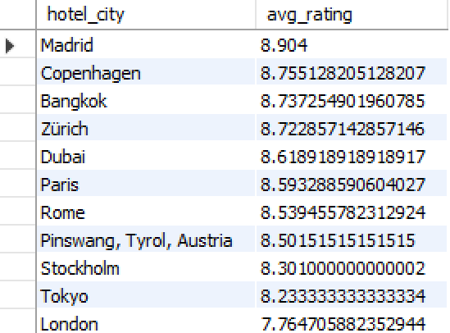
Average Hotel rating per city
SELECT h.hotel_city, AVG(r.rating) AS
avg_rating
FROM hotels h
JOIN reviews r ON h.hotel_UUID = r.hotel_UUID
GROUP BY h.hotel_city
ORDER BY avg_rating DESC;
M

Slide 15
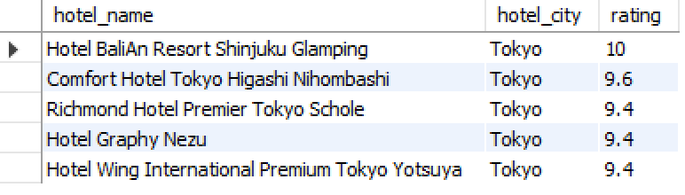
Top 5 hotels by customer ratings
SELECT h.hotel_name, h.hotel_city, r.rating
FROM hotels h
JOIN reviews r ON h.hotel_UUID = r.hotel_UUID
WHERE h.hotel_city = 'Tokyo'
ORDER BY r.rating DESC
LIMIT 5;
M

Slide 16
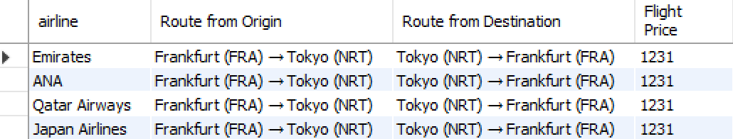
Cheapest flight route
SELECT distinct(f1.airline), f1.`Route from
Origin`,f1.`Route from Destination`,f1.`Flight Price`
FROM flights f1
WHERE f1.destination = 'Tokyo'
AND f1.`Flight Price` = (SELECT MIN(f2.`Flight Price`)
FROM flights f2
WHERE f2.destination = 'Tokyo'
)
ORDER BY f1.`Flight Price` ASC;
M

Slide 17
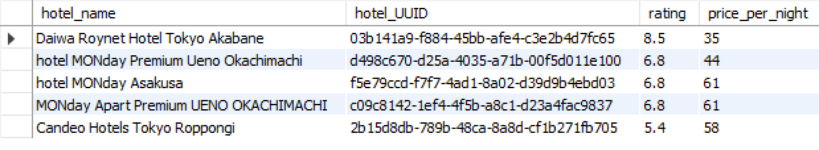
Hotels with best value (low price and high ratings)
SELECT h.hotel_name, h.hotel_UUID, r.rating,
p.price_per_night
FROM hotels h
JOIN reviews r ON h.hotel_UUID = r.hotel_UUID
JOIN prices p ON h.hotel_UUID = p.hotel_UUID
WHERE r.rating > 5.0 AND h.hotel_city = 'Tokyo'
ORDER BY (p.price_per_night / r.rating) ASC
LIMIT 5;
M

Slide 18

Selected hotel with image path
SELECT h.hotel_name, r.rating, p.total_price, i.image_path
FROM hotels h
JOIN reviews r ON h.hotel_UUID = r.hotel_UUID
JOIN prices p ON h.hotel_UUID = p.hotel_UUID
JOIN hotel_images i ON h.hotel_UUID =i.hotel_UUID
WHERE h.hotel_UUID = '03b141a9-f884-45bb-afe4-c3e2b4d7fc65';
M

Slide 19
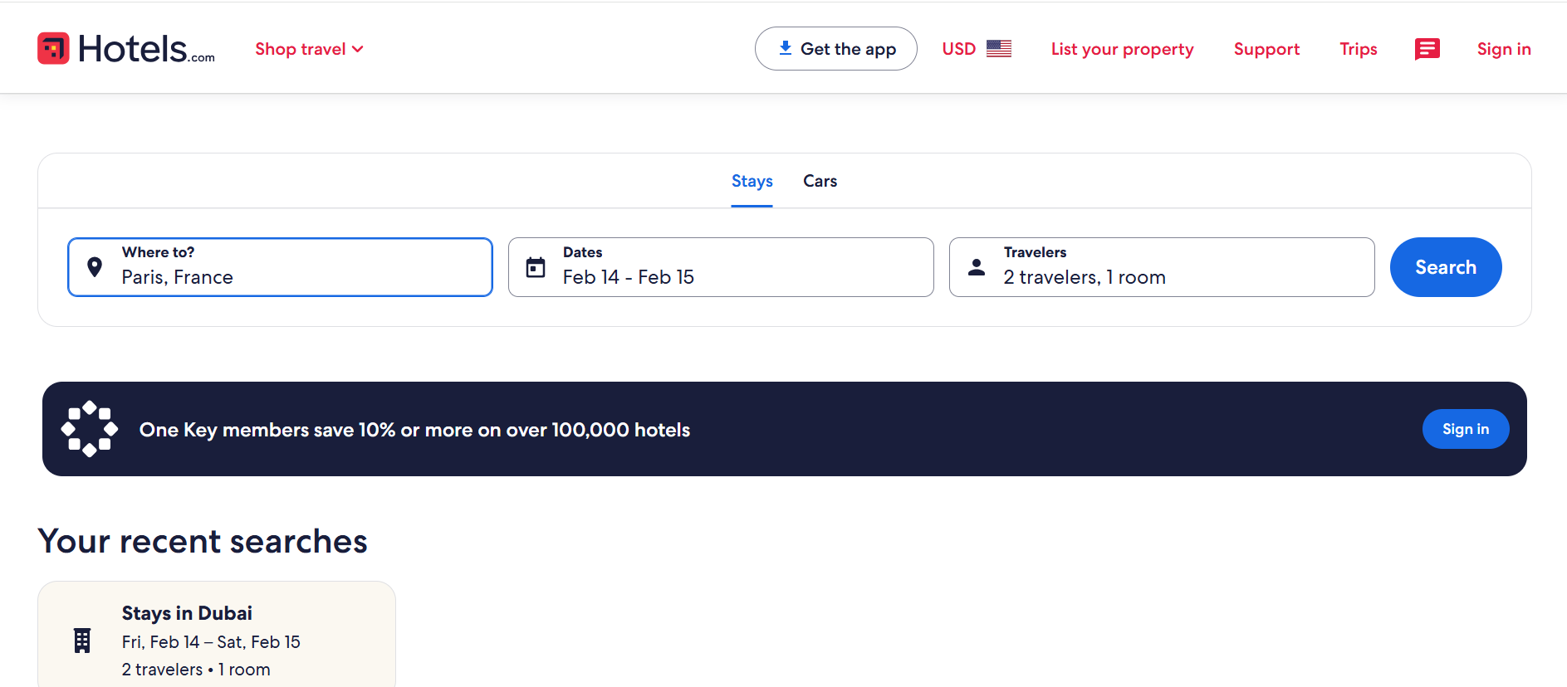
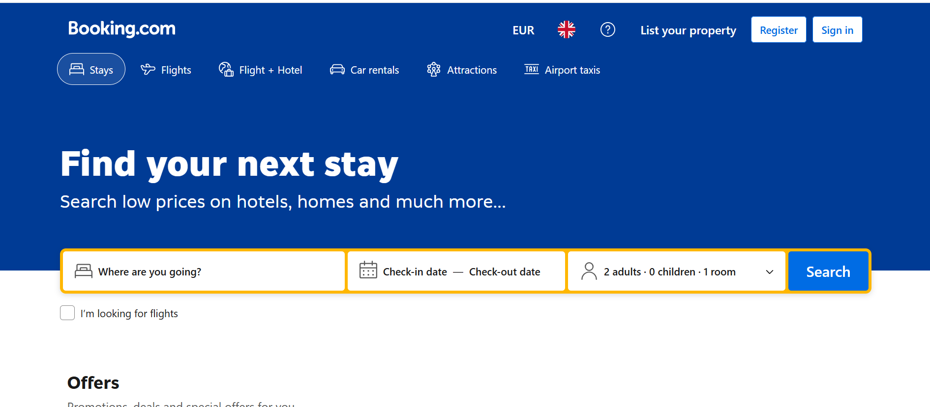
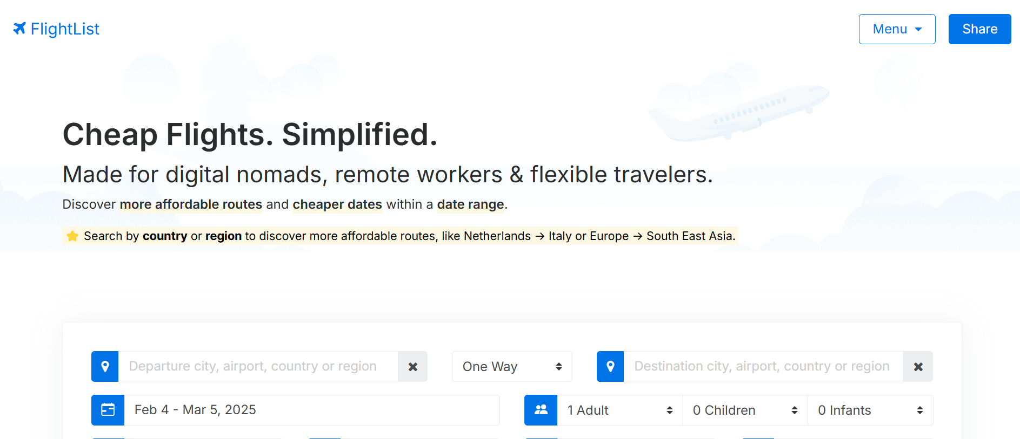
REFERENCES
Websites Scrapped
Hotel_data-
booking.com-https://www.booking.com/
Hotels.com-https://www.hotels.com/
Flight_data-
Flightlist.io-https://www.flightlist.io/
CLI Commands-https://ecampus.srh-university.de/course/view.php?id=4615&section=3#tabs-tree-start

Slide 20



Our team
Varsha Sowri Rajan
100001336
Pooja
100002057
Nimish
100003141

Slide 21

THANK YOU
m

